Slide 1

Costco Wholesale Business Insights(POC)
In response to the in-depth insights provided by the Sales View, Finance View, Marketing View, Supply Chain View, and Executive View
Presented By : Srikanth Reddy
Note: All data presented herein is dummy data for illustrative purposes only.

Slide 2
TABLE OF CONTENTS
01.
02.
03.
04.
05.
06.
07.
Sales View
Finance View
Marketing View
Supply Chain View
Executive View
Suggestions/Support
INFO
Redirects to Costco website.
Get P & L statement
And Day Sales
for any customer / product / country or aggregation of the above over any time period and More...
Analyze performance
of your customer(s)
over key metrics like
Net Sales, Gross
Margin and view the
same in profitability / Growth matrix.
Analyze the
performance of your product(s) over key
metrics like Net Sales, Gross Margin and
view the same in
profitability / Growth matrix.
Get Forecast
Accuracy, Net Error
and risk
profile for product, segment, category, customer etc.
A top level
dashboard for
executives
consolidating top
insights from all dimensions of business.
Get your issues /suggestions resolved by connecting to our support specialist.

Slide 3
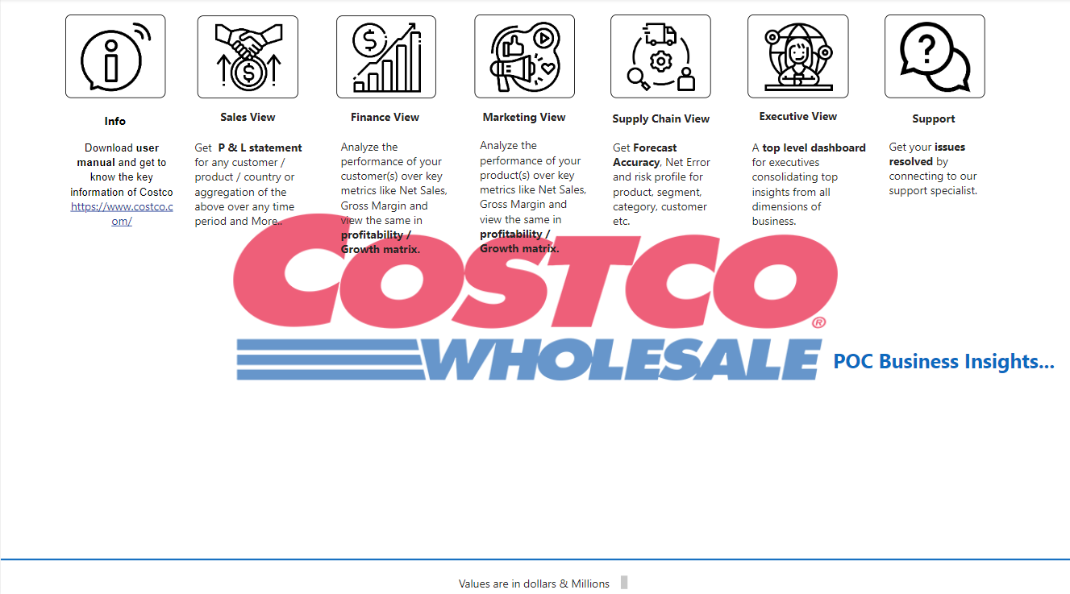
Home Page
This is the starting page of the application. Navigate to the respective view based on your selection.

Slide 4
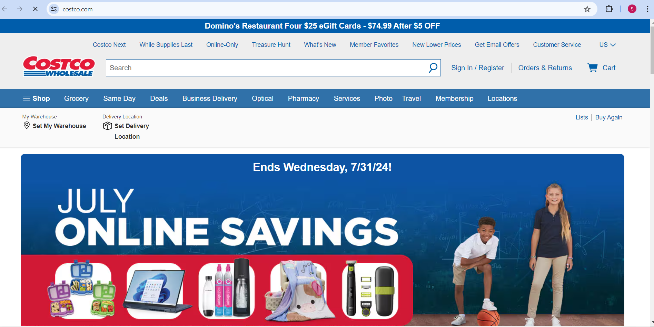
Info Page
Once you click on 'Info', you will be redirected to the Costco website, where any one can check offers, product availability, and the latest updates.

Slide 5
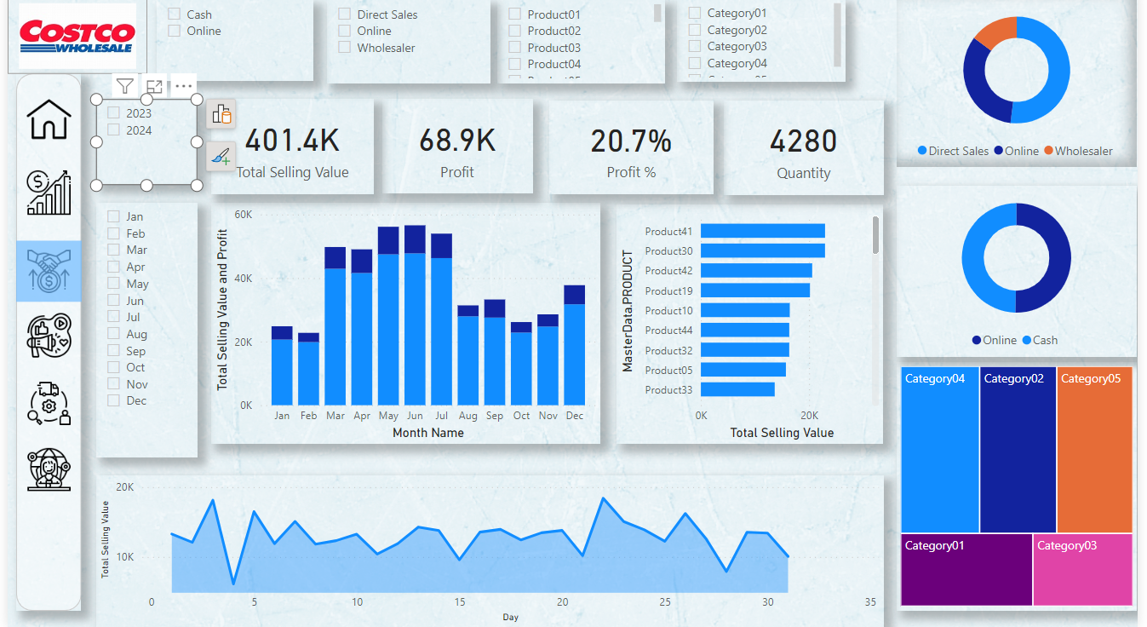
Sales View
This Dashboard will describes about revenue trend by Day/Week/Month/Year.
Top selling product.
Sales Chart visual Over day wise.
Top Selling value and profit by particular Month.
Multiple KPI’s developed to see business insights(total selling value, profit, Profit%, Quantity sold on specific day).
Single/multiple product sales can be shown
Here Category can be considered as different departments(Bakery, Café, Optical, Merchandise). We can see all/single category sales

Slide 6
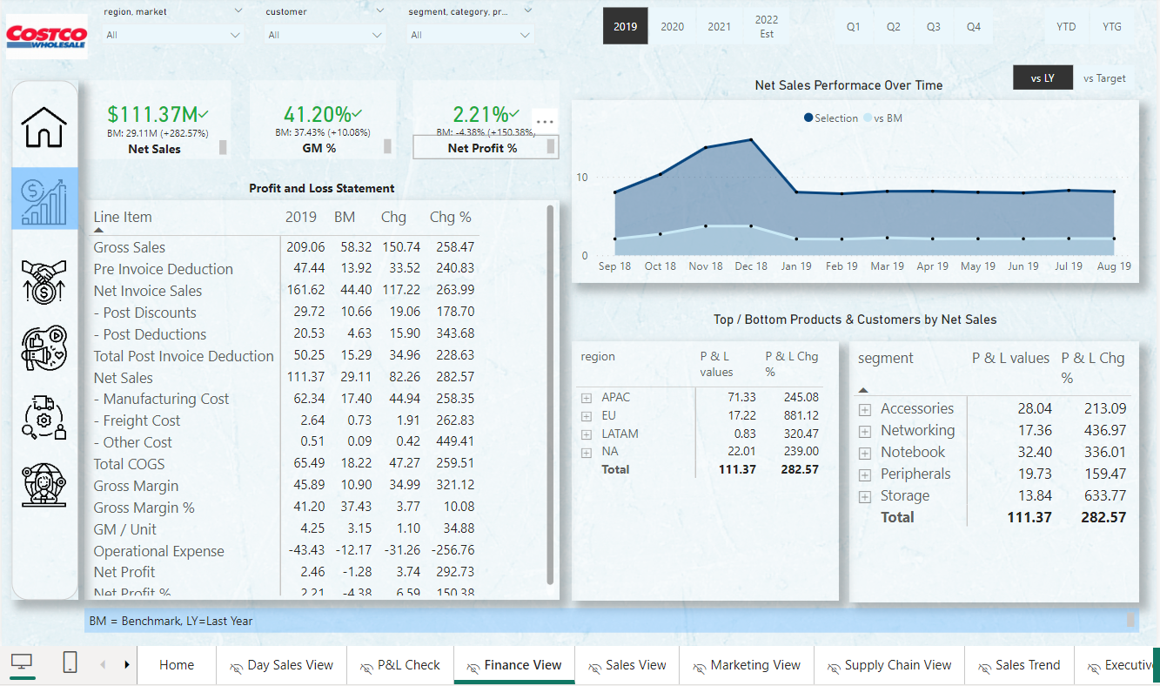
Finance View
This Dashboard is used to Analyze the performance of your customer(s) over key metrics like Net Sales, Gross Margin and view the same in profitability / Growth matrix.
We can check our results over vsLY and vsTarget.

Slide 7
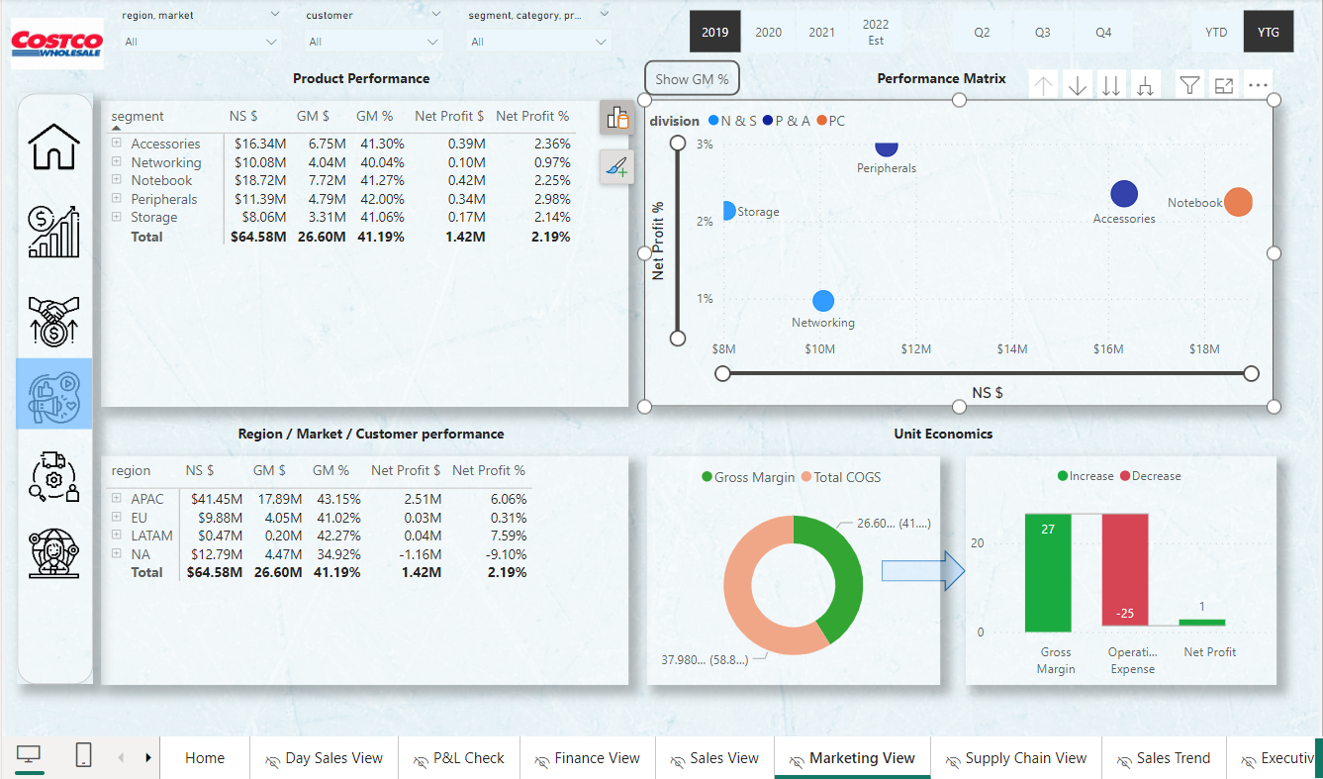
Marketing View
We can check our performance of product(s) over key metrics like Net Sales, Gross Margin and view the same in profitability / Growth matrix.
We can Filter as per Region market, Customer, segment, category, Product over Year To Date(YTD) and Year To Growth(YTG).

Slide 8
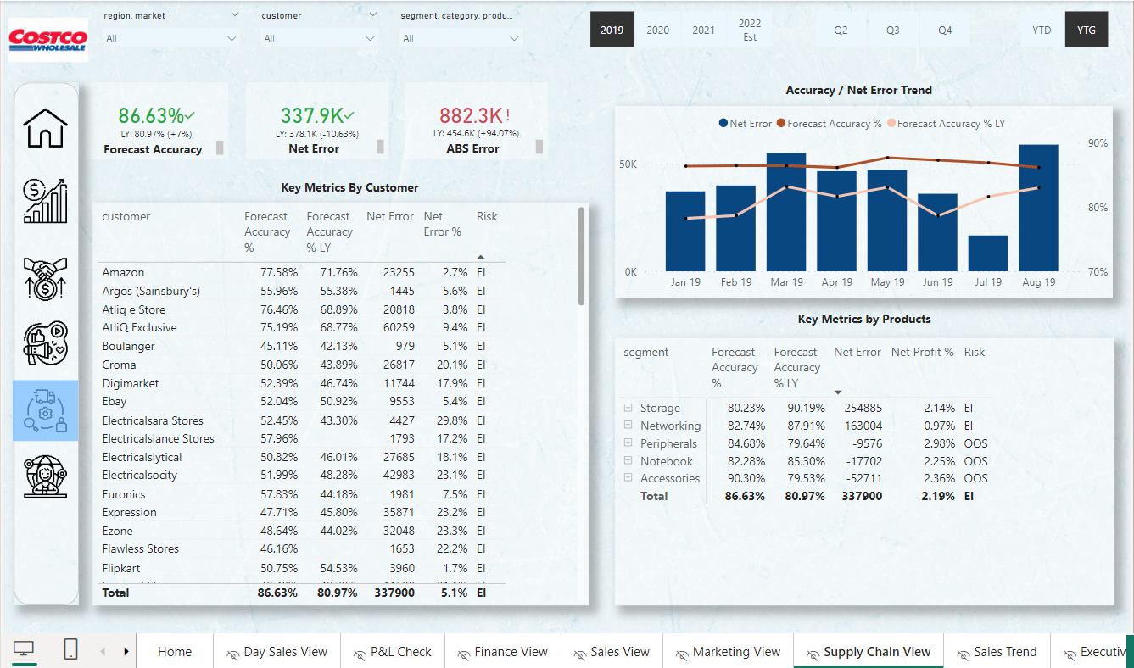
Supply Chain
This Dashboard is used to get Forecast Accuracy, Net Error and risk profile for product, segment, category, customer etc.
Added useful KPI’s like Forecast Accuracy, Net Error, ABS Error.

Slide 9
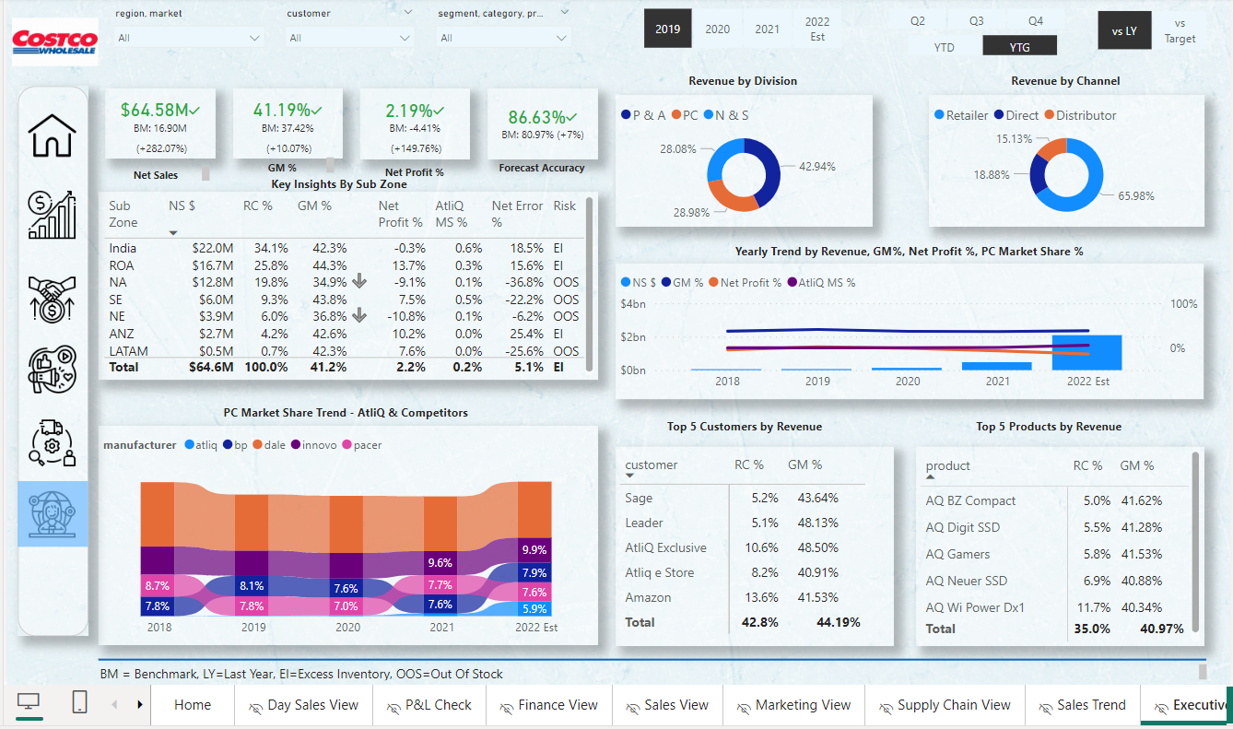
Executive View
A top level dashboard for executives consolidating top insights from all dimensions of business.
All insights which is data privacy to the organization would not be displayed to all executives. RLS would be provided.

Slide 10
Support/Suggestions
This page will take to any issues or suggestions reported by Employees for Warehouse/process Improvements.

